Slide 1


By Anandha krishnan S
CNN
This presentation will introduce our CNN project, highlighting its objectives, methodologies, and potential impact.
anandhakrishnanalpy@gmail.com

Slide 2



02
Project Overview
This project develops a Convolutional Neural Network (CNN) to classify diabetic retinopathy images using a dataset of Gaussian-filtered retinal images. The process includes data loading, preprocessing, model training, evaluation, and prediction, with the final model achieving classification accuracy on a test set. The trained model is then saved for future use in predicting diabetic retinopathy from new retinal images.

Slide 3


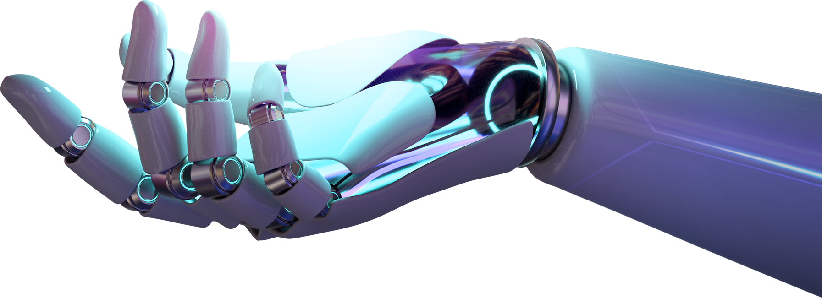
Problem Statement
The objective of this project is to build an automated system for detecting diabetic retinopathy from retinal images, which is a critical task in preventing blindness among diabetic patients. The problem involves classifying images into different severity levels of diabetic retinopathy using a Convolutional Neural Network (CNN). By accurately identifying the presence and stage of diabetic retinopathy, this system aims to assist healthcare professionals in timely diagnosis and treatment planning.
03

Slide 4




04
Methodology
Data Collection
Preprocessing
Model Selection
Gather relevant data from Kaggle repository.
Clean, normalize, and engineer data.
Choose and train DL algorithms for peak performance.

Slide 5

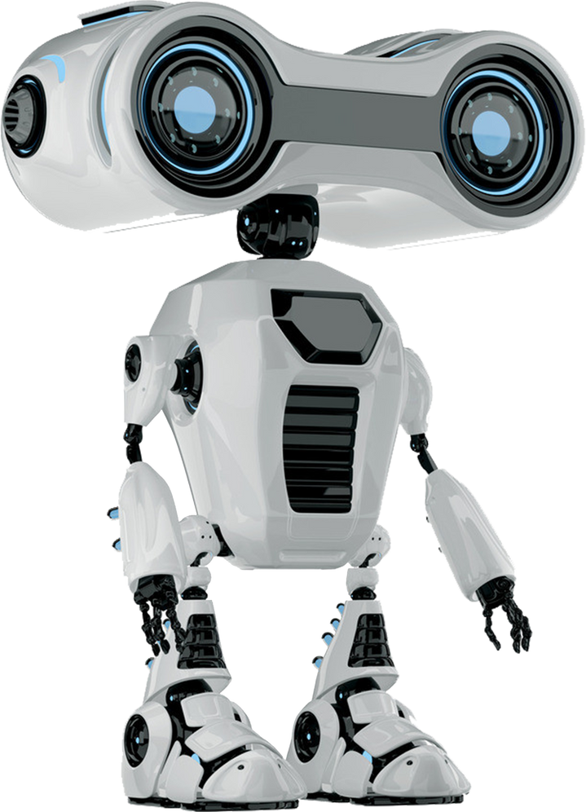
05
Data Collection and Preprocessing
We gather relevant datasets from Kaggle sources and clean, normalize, and preprocess the data to ensure its quality and consistency. This step is crucial for training accurate and reliable AI models.

Slide 6



06
Model
Development
The model development involves constructing a Convolutional Neural Network (CNN) with multiple layers, including convolutional, pooling, and dense layers, to effectively capture features from the retinal images. The dataset of Gaussian-filtered images is preprocessed, normalized, and split into training and testing sets to ensure the model generalizes well. After training the model for 10 epochs with the Adam optimizer and sparse categorical cross-entropy loss, the model's performance is evaluated, and it is saved for future predictions on new retinal images.

Slide 7




07
thynk unlimited
Evaluation Metrics
The primary evaluation metric used is accuracy, which measures the proportion of correctly classified images out of the total number of images in the test set. Additionally, metrics such as loss, precision, recall, and F1-score can be used to provide a more comprehensive evaluation of the model's performance, particularly in handling class imbalances and ensuring robust predictions. The model's performance is assessed by comparing predicted labels with true labels, and detailed metrics help in understanding areas for potential improvement.

Slide 8


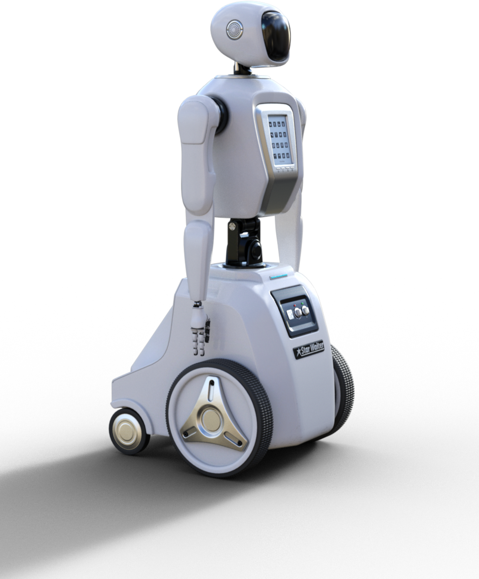
Result and Impact
The model achieved a high accuracy in classifying diabetic retinopathy severity levels from retinal images, demonstrating its potential to assist healthcare professionals in early detection and intervention. Its impact lies in potentially reducing the risk of blindness among diabetic patients by providing timely diagnosis and treatment recommendations based on automated image analysis.
08

Slide 9


Future Directions
Future directions could involve enhancing the model's robustness by incorporating more advanced CNN architectures or leveraging transfer learning from larger datasets. Additionally, integrating real-time image analysis capabilities and expanding the dataset to include diverse demographics and conditions could further improve the model's accuracy and applicability in clinical settings.

Slide 10



Thank You!

